Slide 1

Youth homelessness – what’s the problem?
DataKind DataDive
17 July 2015

Slide 2
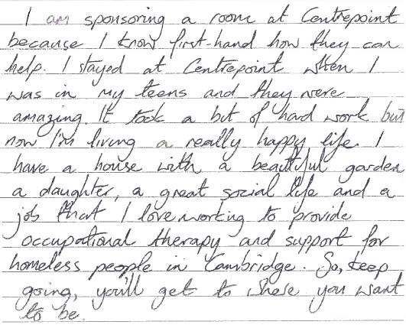
Young people are REAL people who want to achieve something

Slide 3
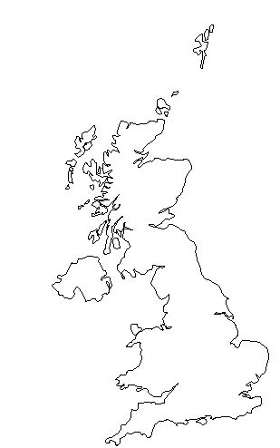

Challenge / Goal
How many young people are facing homelessness in the UK?
Eeerrr…no one knows!
Official data:
Not reported by age
Unreliable
Underestimate the problem

Slide 4

How we dominated the data problem
Bad-ass teams
Data dream cleaners
Strategy model builders
Data retrievers
Mappers
Data flow visualisers
Sunday AM!

Slide 5

MAJOR Achievement No. 1
DATA FIXED! (3 overlapping sources across 3 variables)
A clean, usable dataset
Ready for further analysis
WITH contextual data integrated

Slide 6
MAJOR Achievement No. 2
An estimate of the number of young people presenting as homeless to their local authority
Ethnicity
Unemployment
Deprivation
Official figure:
13,500

Slide 7
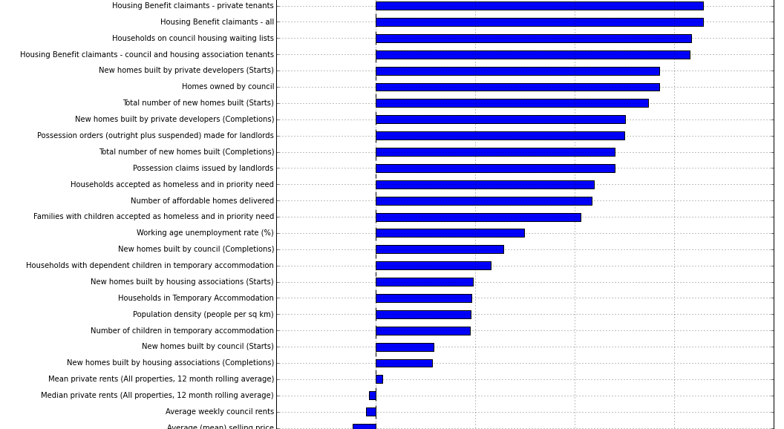
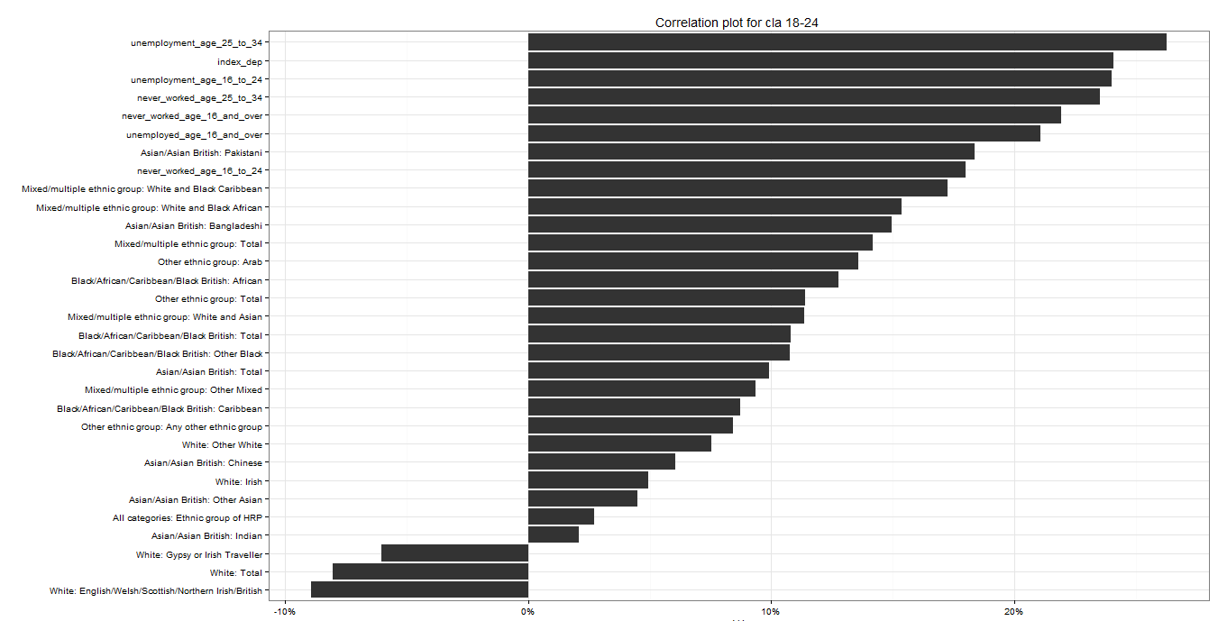
A complex model...

Slide 8
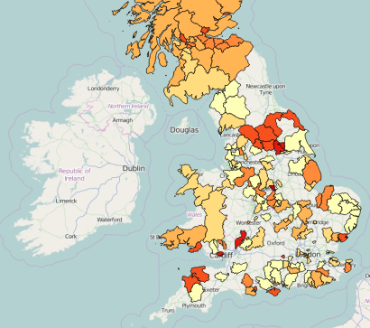
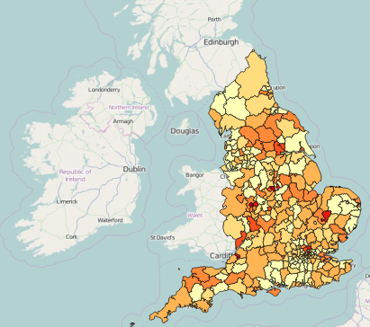
Model shows the gaps as priority areas

Slide 9
MAJOR Achievement No. 2
An estimate of the number of young people presenting as homeless to their local authority
Ethnicity
Unemployment
Deprivation
95,000
13,500?
NO!

Slide 10
MAJOR Achievement No. 3
Map
Outlier or real situation?
Data vs no data (is the problem bigger where we there was no data?)

Slide 11
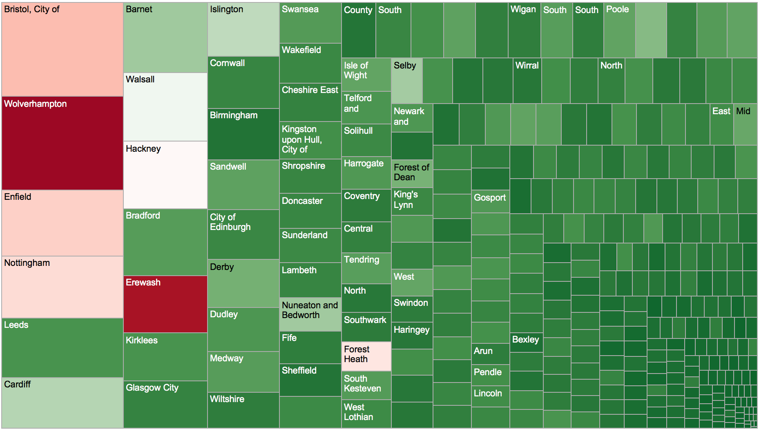
4 Worst cities did not report data

Slide 12
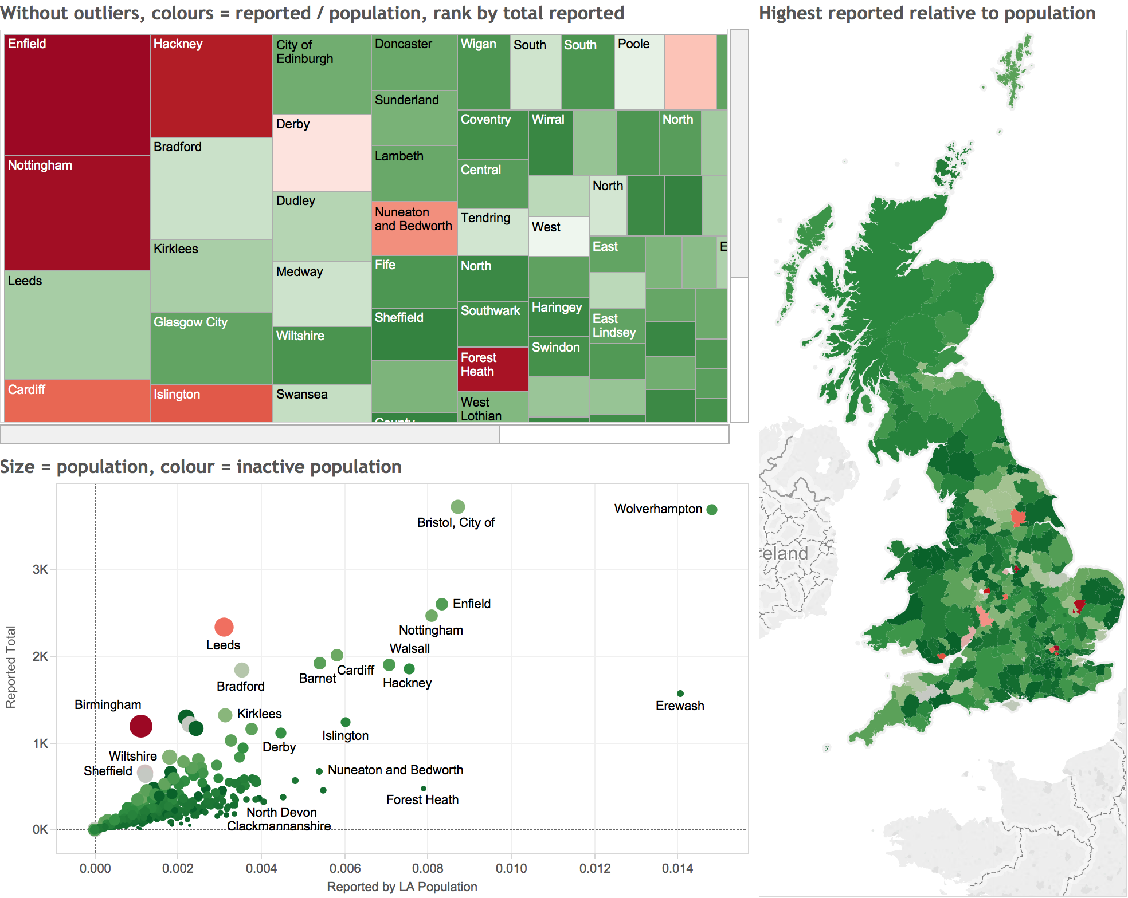
Dashboard to present to local authorities

Slide 13
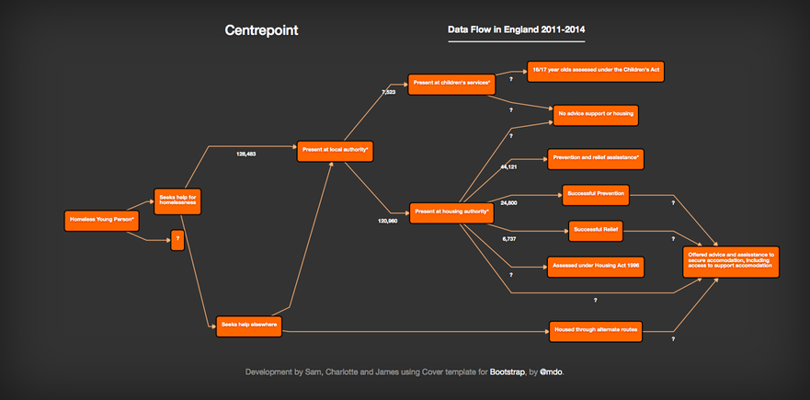
MAJOR Achievement No. 4
Interactive data flow

Slide 14
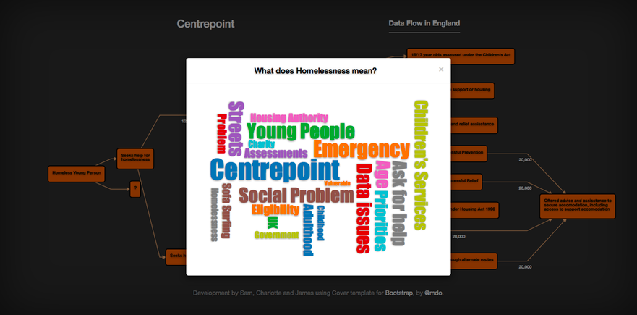
MAJOR Achievement No. 4
Interactive data flow

Slide 15

Impact
1st estimate of youth homelessness across the UK!
Makes sense of bad data (for good!)
Illustrate data problem to sector
Engage those who currently hold the data on youth homelessness
Improve data collection and sharing
Understand more about youth homelessness
Improve the lives of real young people

Slide 16

What next for us?
So much to do, thanks to YOU!
More analysis (incl. Wales)
Release data onto open platform
Launch Youth Homelessness Databank
Press release
Make a case to DCLG (gov)
Build relationships
Local gov
Charities and housing providers
Centrepoint’s next BIG campaign
This estimate will be the centrepiece
Share all learning and documentation with newly appointed digital partner
Notes:
16

Slide 17

What next for you?
VOLUNTEERS!

